Slide 2
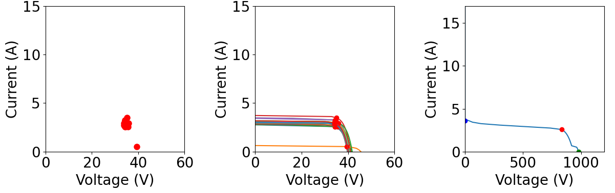
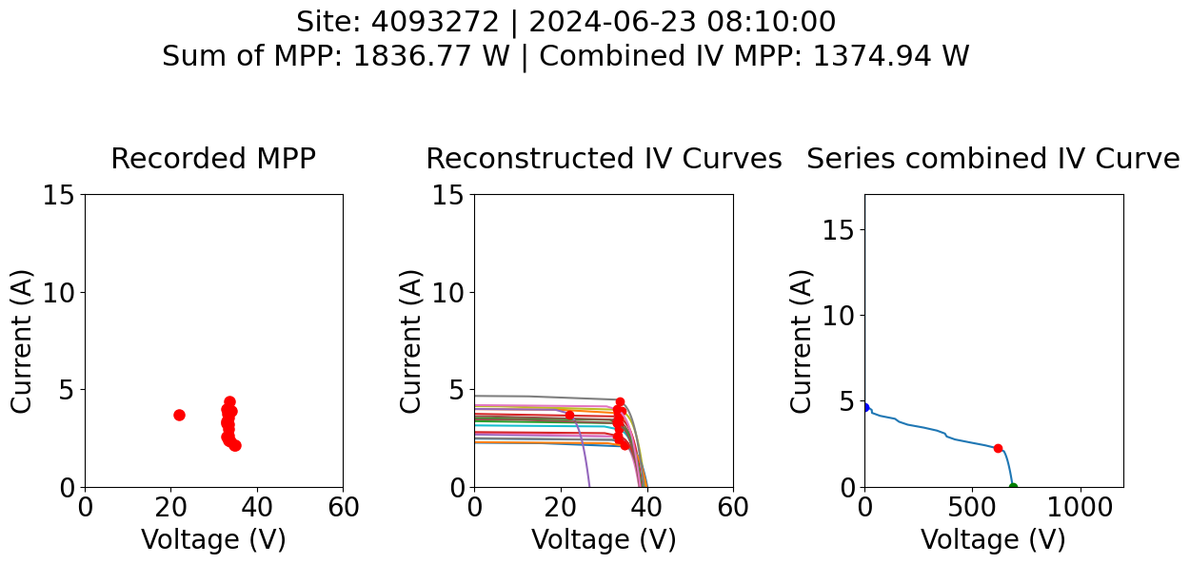
Case 1 diode activation example
Raw MPP data
Reconstructed IV
Combined IV in series
Case 2 diode activation example
Raw MPP data
Reconstructed IV
Combined IV in series

